Slide 1
Nate Brea and the Island of Borrowed Powers: PowerPoint Presentation

Slide 2
Team Name and Roles
Alexander McRoberts: Documentation Lead
Kyle O’Donnell: Lead Programmer

Slide 3
Project Overview
Computer Games Design Module:
Produce a Video Game Prototype
Produce a GDD and TDD
Present the Idea to an audience

Slide 4
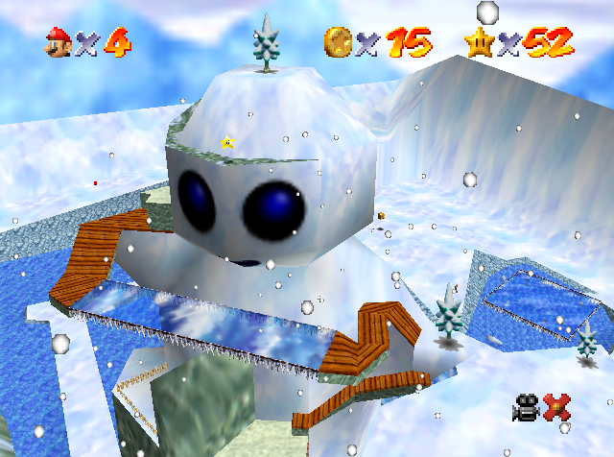
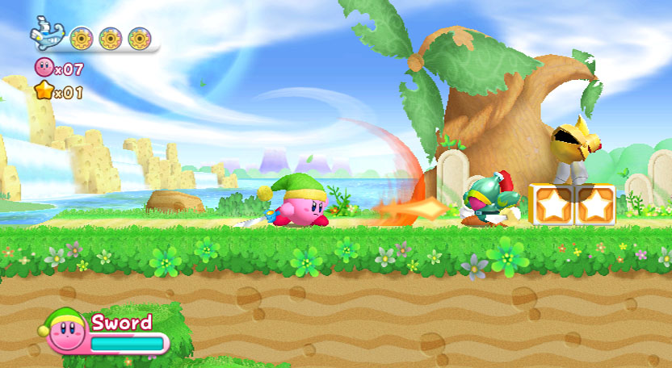
Game Idea and Influences
Nate Brea and the Island of Borrowed Powers is a 3D game
Powers can be taken from defeated enemies.
The player Utilizes these to advance through the levels in a variety of ways.
Allows for a somewhat unique player experience
https://www.mariowiki.com/File:Snowman%27s_Land.png
http://kirby.wikia.com/wiki/File:Kirby_RtDL_4.jpg

Slide 5
Game Details and Specifics
3D platformer.
Produced in Unity.
Coded with C#
Models produced in Autodesk Maya.
Chibi art style.

Slide 6
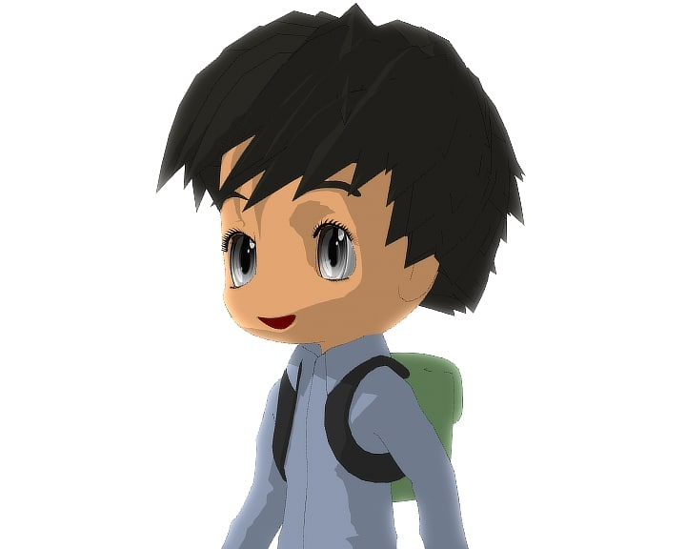
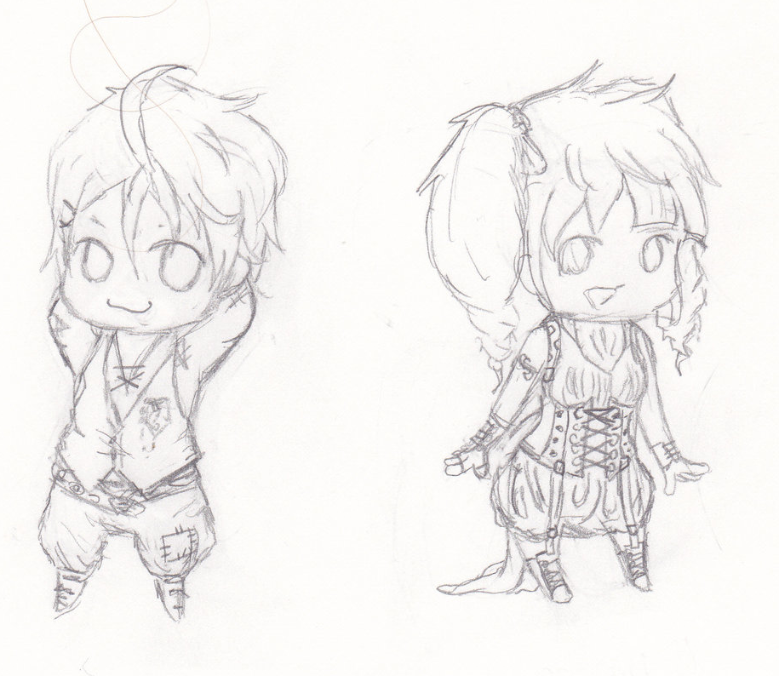
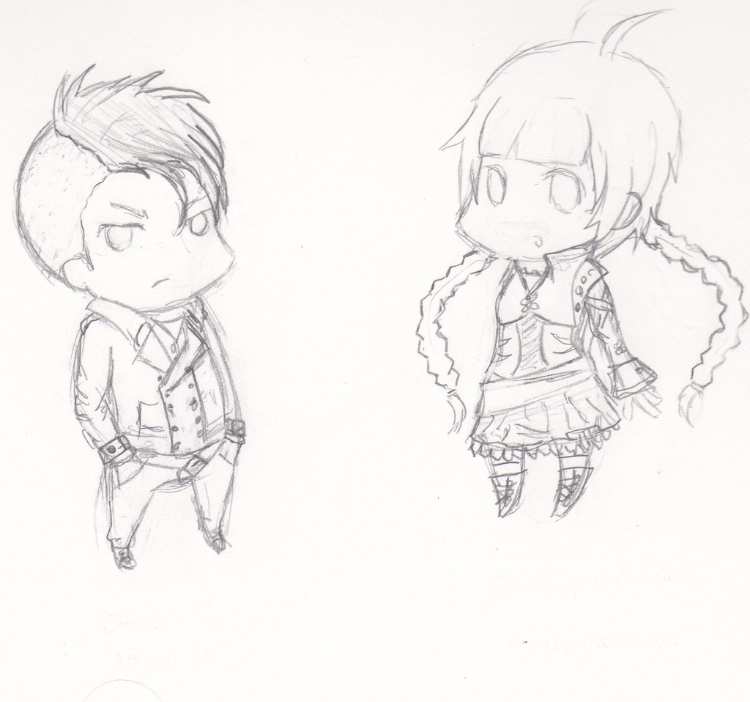

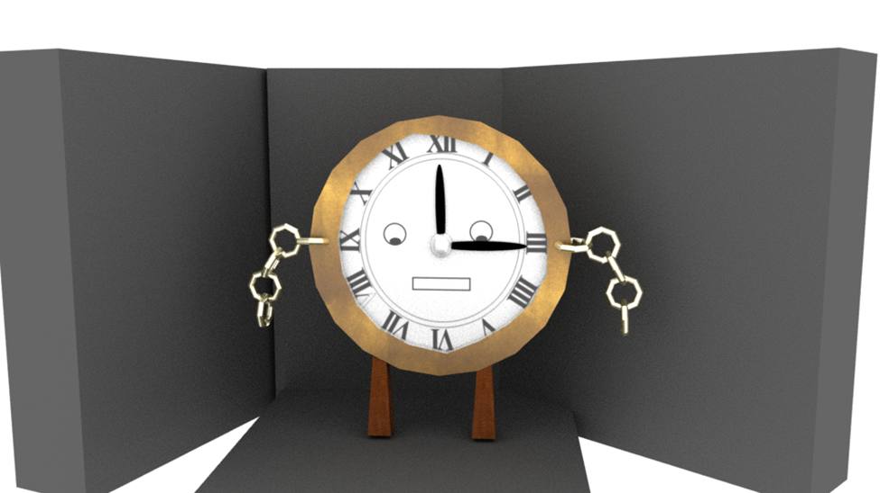
https://www.turbosquid.com/3d-models/3d-model-male-chibi-version-2/599151
http://www.cadnav.com/3d-models/model-39046.html

Slide 7
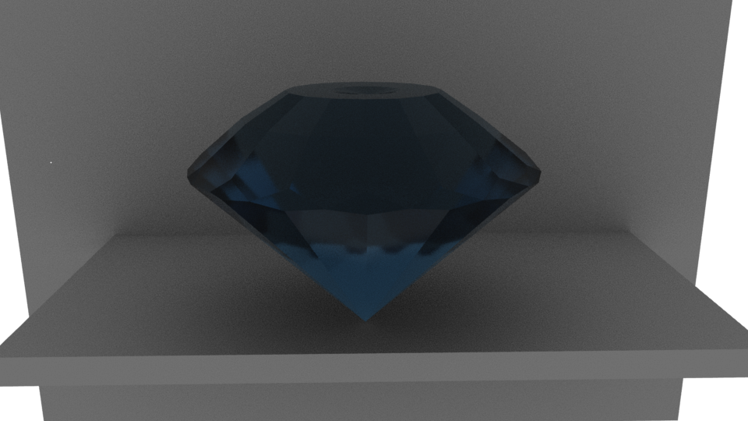
Game Play and Mechanics
Assorted Powers to use
Gems to collect
In game store

Slide 8
Images related to previous slide
Include images related to the previous slide

Slide 9
Level Design Approach
Levels were designed in a back-to-front manner
Implemented in a vague form then
Large levels
Mostly open levels.

Slide 10

Game Audio
Produced with Audacity.
Produced with BFXr

Slide 11
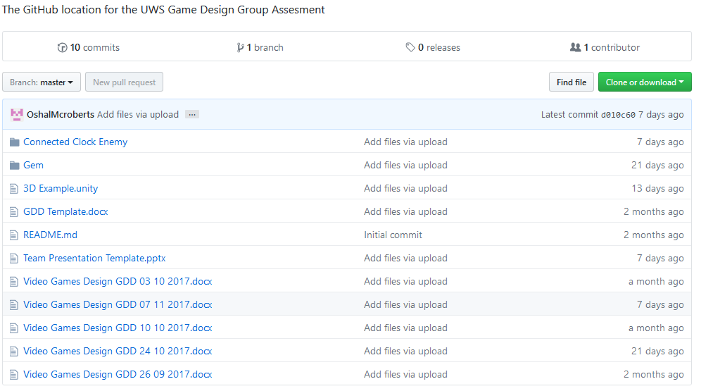
Project Management and Version Control
Used Github for:
Storing Documents and files.
Version Control.
Used Google Drive for:
Uploading the game.

Slide 12
Game Implementation
Prototype was developed with something similar to the Agile methodology approach.
Mostly independent work with distance communication
Long distance communication
Communication hiccups.

Slide 13
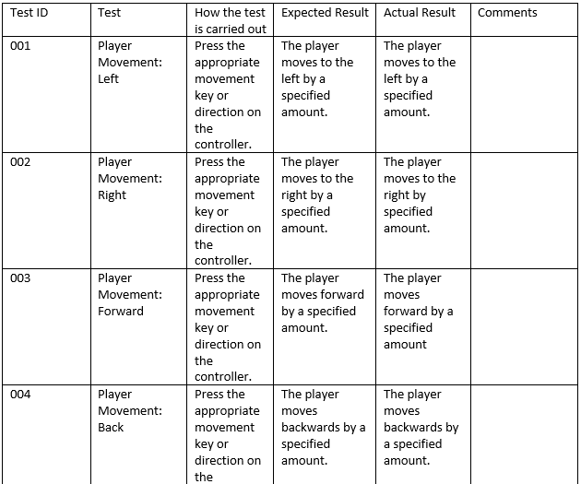
Testing and Quality Assurance
Black box testing was used
Tests were carried out constantly throughout implementation
A test plan was used

Slide 14
Prototype
Show a video recording of the prototype in action (5 minutes minimum)

Slide 15
Things Learned during the Project
Team management skills
Communication Skills
Maya Skills
Unity Skills
Hardware issues

Slide 16
Any Questions?
Feel Free to ask.

